Slide 1
Case Study: Wet’suwet’en
Using the lenses of indigenous history, indigenous sovereignty and rights, and environmental leadership

Slide 2
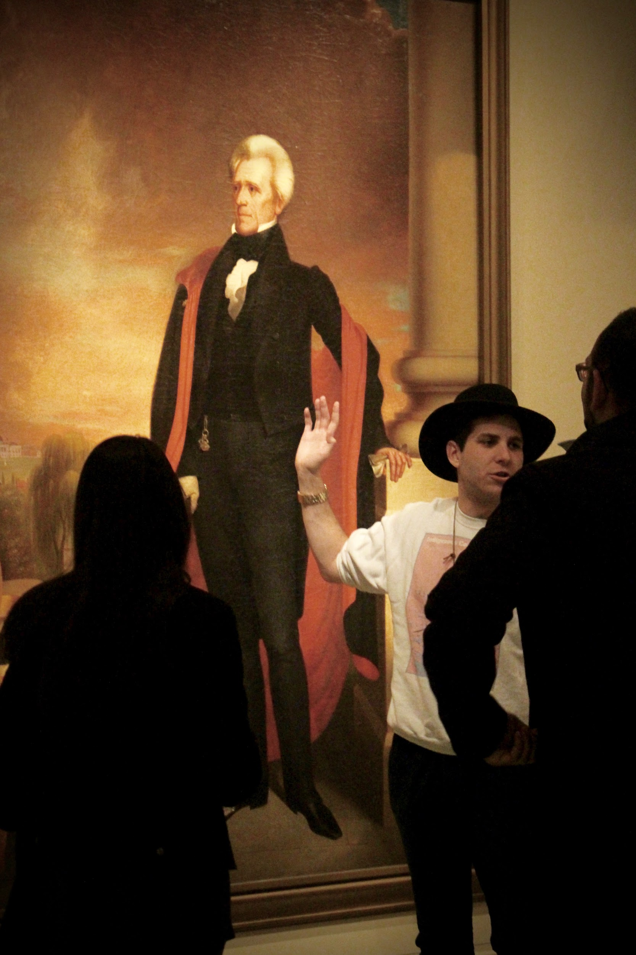
DeLesslin George-Warren (Catawba)
@delesslin
delesslingw@gmail.com
delesslin.com

Slide 3
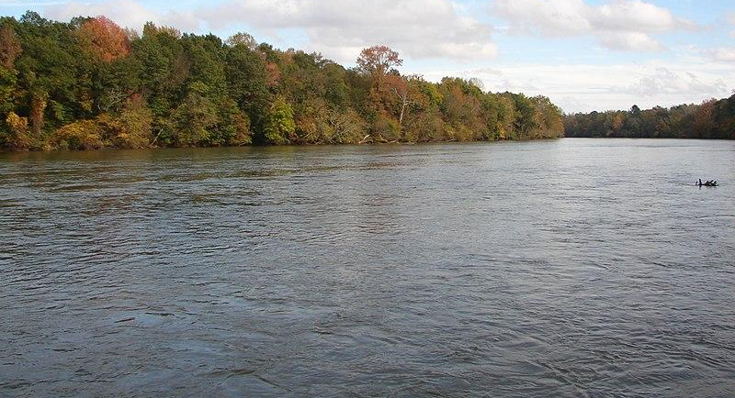
wikimedia.org

Slide 4
Agenda
Map
Timeline
Current Situation

Slide 5
*DISCLAIMER*

Slide 6
Message from Mashpee Chairman: We Will Take Action to Prevent the Loss of Our Land - Friday, March 27, 2020
“At 4:00 pm today -- on the very day that the United States has reached a record 100,000 confirmed cases of the coronavirus and our Tribe is desperately struggling with responding to this devastating pandemic -- the Bureau of Indian Affairs informed me that the Secretary of the Interior has ordered that our reservation be disestablished and that our land be taken out of trust. Not since the termination era of the mid-twentieth century has a Secretary taken action to disestablish a reservation.”

Slide 7
Message from Mashpee Chairman: We Will Take Action to Prevent the Loss of Our Land - Friday, March 27, 2020
“Today's action was cruel and it was unnecessary. The Secretary is under no court order to take our land out of trust. He is fully aware that litigation to uphold our status as a tribe eligible for the benefits of the Indian Reorganization Act is ongoing.
It begs the question, what is driving our federal trustee's crusade against our reservation?”

Slide 8
Message from Mashpee Chairman: We Will Take Action to Prevent the Loss of Our Land - Friday, March 27, 2020
“Regardless of the answer, we the People of the First Light have lived here since before there was a Secretary of the Interior, since before there was a State of Massachusetts, since before the Pilgrims arrived 400 years ago. We have survived, we will continue to survive. These are our lands, these are the lands of our ancestors, and these will be the lands of our grandchildren. This Administration has come and it will go. But we will be here, always. And we will not rest until we are treated equally with other federally recognized tribes and the status of our reservation is confirmed.”

Slide 9
Message from Mashpee Chairman: We Will Take Action to Prevent the Loss of Our Land - Friday, March 27, 2020
“I will continue to provide updates on this important issue in the coming days as we take action to prevent the loss of our trust status.
Kutâputunumuw;
Chairman Cedric Cromwell
Qaqeemasq (Running Bear)”

Slide 10
#StandWithMashpee
Petition: https://sign.moveon.org/petitions/stand-with-the-mashpee

Slide 11
protestors
PROTECTORS

Slide 12
Maps of the Land

Slide 13
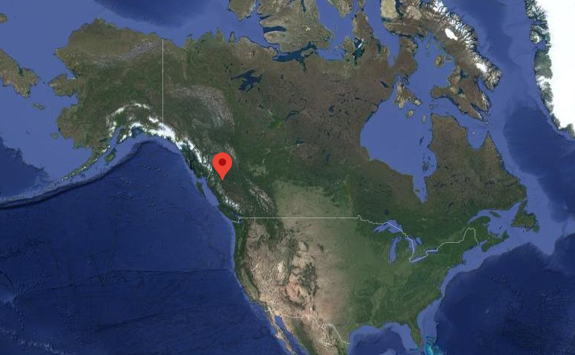
Google Maps

Slide 14
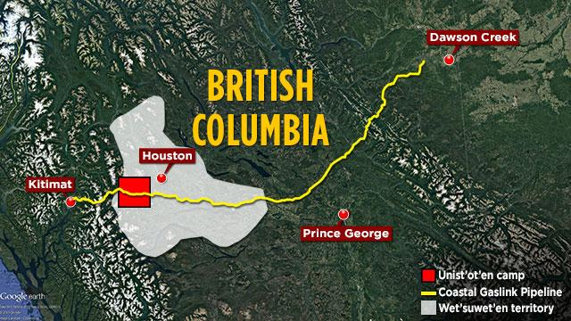
APTN

Slide 15
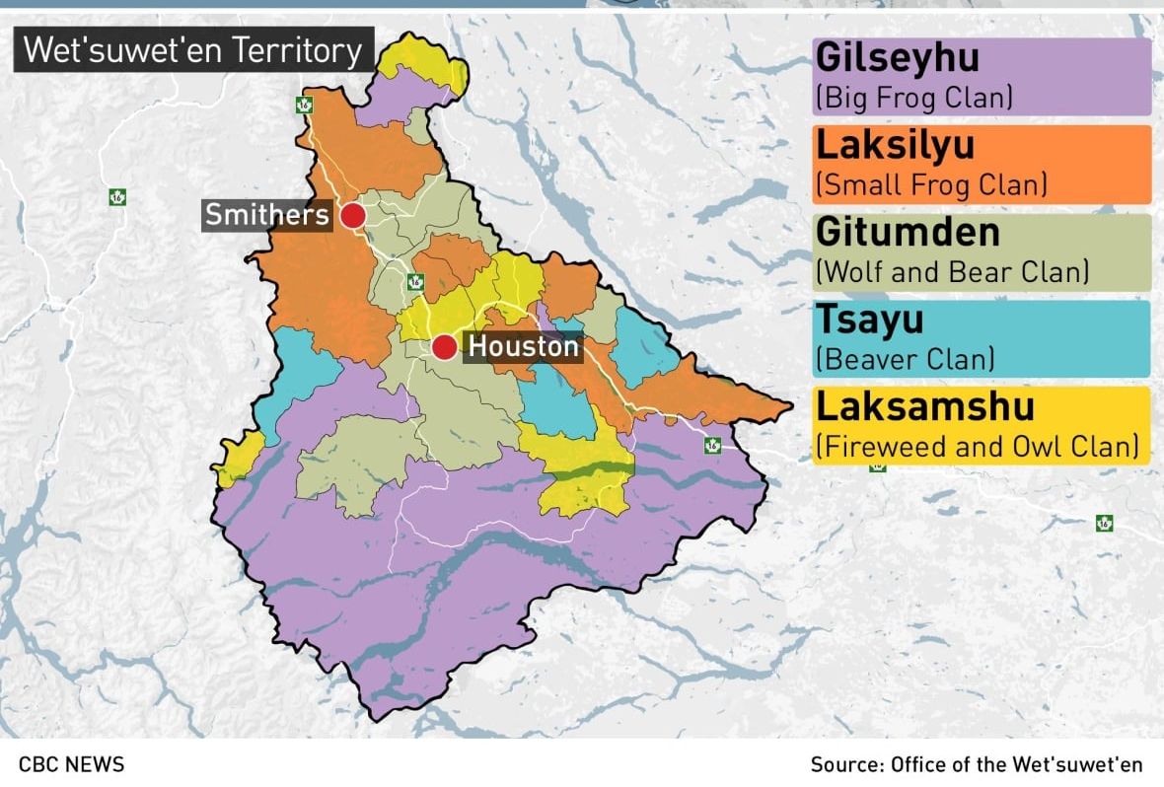

Slide 16
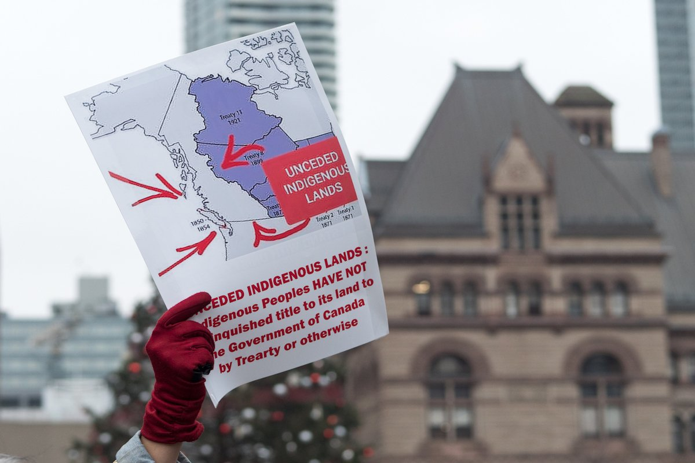
Now Toronto

Slide 17
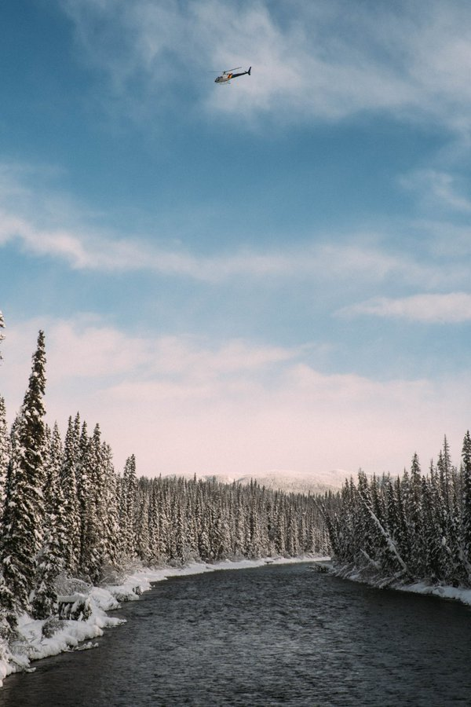
Michael Toledano (@M_Tol) Feb 1, 2020

Slide 18
1867
Canada established

Slide 19
1876
Indian Act

Slide 20
Dec 11, 1997
Delgamuukw Supreme Court Case

Slide 21
2007
Pacific Trails Pipeline Interest and Use Study

Slide 22
2008
Wet’suwet’an Clans unanimously opt out of Treaty Process

Slide 23
2009
Wedzin Kwa Checkpoint Established

Slide 24
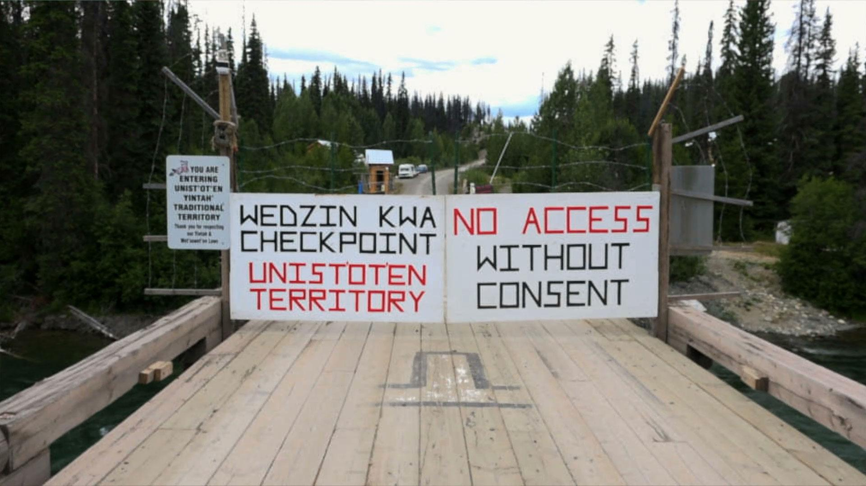
stopfossilfuels.org

Slide 25
Article 19 (UNDRIP):
“States shall consult and cooperate in good faith with the indigenous peoples concerned through their own representative institutions in order to obtain their free, prior and informed consent before adopting and implementing legislative or administrative measures that may affect them.” (emphasis added)

Slide 26
April 5, 2010
Construction begins on Log Cabin

Slide 27
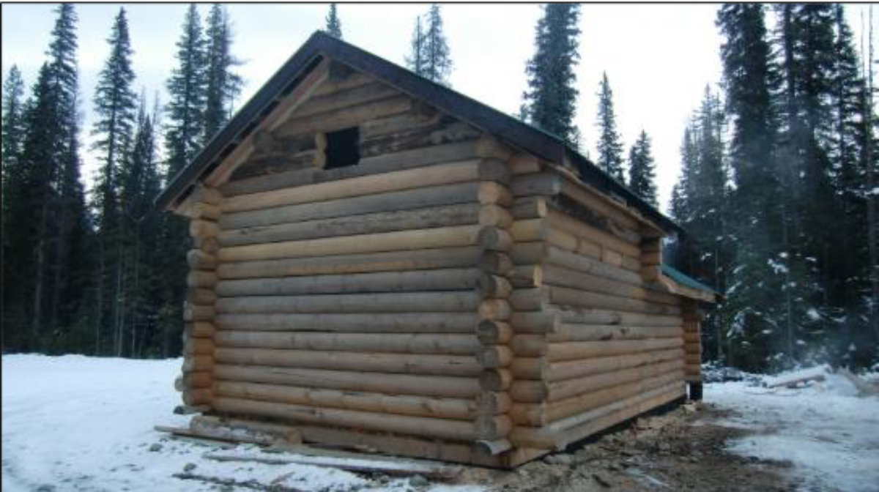
itsgoingdown.org

Slide 28
Dec 1, 2011
Gitxsan Nation blocks entry to Treaty Office to contest deal

Slide 29
April 11, 2012
Protectors go on speaking tour

Slide 30
August 1, 2012
3rd Annual Unist’ot’en Action Camp

Slide 31
Unistoten camp

Slide 32
July 1, 2013
Pithouse construction begins

Slide 33
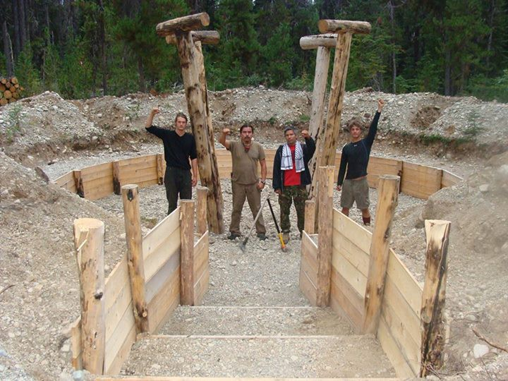
briarpatchmagazine.com

Slide 34
August 1, 2014
Bunkhouse construction begins

Slide 35
June 1, 2015
Healing Centre construction begins

Slide 36
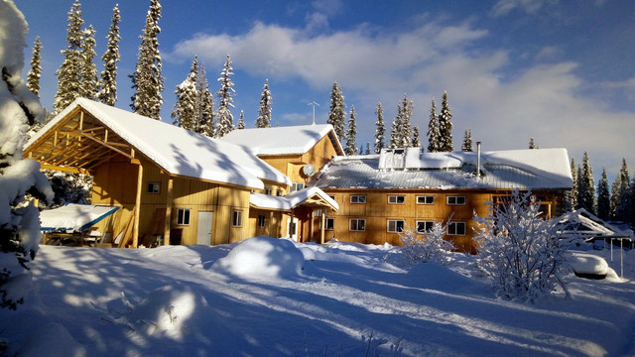
unistoten.camp

Slide 37
Sept 3, 2015
Hereditary Chiefs visit camp and assert support

Slide 38
May 8, 2017
Healing Center Completed

Slide 39
June 26, 2018
TransCanada Corp announces financial agreements with First Nations

Slide 40
Nov 23, 2018
Coastal GasLink Pipeline applies for an injunction

Slide 41
Dec 14, 2018
Coastal GasLink is granted a temporary injunction

Slide 42
Jan 7, 2019
RCMP Tactical Unit invades Gidumt’en Checkpoint

Slide 43
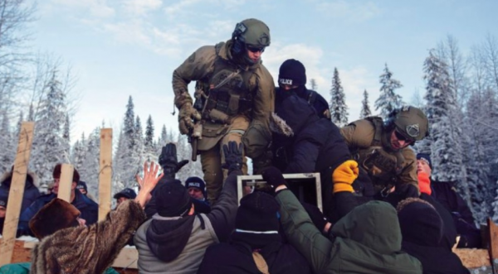
popularresistance.org

Slide 44
Article 10 (UNDRIP):
“Indigenous peoples shall not be forcibly removed from their lands or territories. No relocation shall take place without the free, prior and informed consent of the indigenous peoples concerned and after agreement on just and fair compensation and, where possible, with the option of return.”

Slide 45
Jan 8, 2019
Global Solidarity Actions

Slide 46
“The challenge for governments, federal and provincial, is determining how we bring together the historic band council model [of governance] with... the emerging hereditary model that’s very much manifesting itself on Wet’suwet’en territory.” - BC Premier John Hogan

Slide 47
Dec 31, 2019
British Columbia Supreme Court grants Coastal GasLink an injunction

Slide 48
Jan 1, 2020
The Wet’suwet’en First Nation serves Coastal GasLink with an eviction notice

Slide 49
January 30
Hereditary Chiefs agree to meetings with Province

Slide 50
February 6
RCMP move into Wet’suwet’en Territory to enforce court injunction, setting off weeks of intense inter-tribal action

Slide 51

CBC News

Slide 52
Feb 27
Coastal GasLink Suspends construction for 2 days

Slide 53
March 2
Discussions continue & agreement on sovereignty

Slide 54
What now?

Slide 55
Questions? Comments? Fears? Hopes?
@delesslin
delesslingw@gmail.com
delesslin.com

